Slide 1
CSC 455: Database Processing for Large-Scale Analytics
Lecture 8
Alexander Rasin
College of CDM, DePaul University
November 12th, 2013

Slide 2
Tonight
Python
Reading/saving files
Data transformation
Indexes
Materialized views

Slide 3
Reading from the Web
import urllib2
webFD=urllib2.urlopen("http://rasinsrv07.cstcis.cti.depaul.edu/CSC455/tweet_data.txt")
webFD.read(100)
webFD.readline()
webFD.close()

Slide 4
DataFrames
numpy.arange(40)
numpy.arange(40).reshape((4,10))
numpy.arange(40).reshape((4,10))
frame = pandas.DataFrame(numpy.arange(20).reshape((4,5)), index = ['two', 'one', 'three', 'four'], columns = ['b','a','d','c','f'])

Slide 5
Reading/Writing Data
pandas.read_csv('text1.txt')
pandas.read_table('text1.txt', sep = ',')
No header
  pandas.read_csv('text2.txt', header=None)
pandas.read_csv('text2.txt', names = ['Trial', 'Mass', 'Velocity'])
Notes:
"trial","mass","velocity"
"A",10,12
"A",11,14
"B",5,8
"B",6,10
"A",10.5,13
"B",7,11

Slide 6
Reading/Writing Data
f1 = pandas.read_csv('text3.txt') # Bad data
pandas.read_csv('text3.txt', skiprows=[1,2])
pandas.isnull(f1)
a = pandas.read_csv('text3.txt', na_values={'Col1':['A']})
pandas.read_csv('text3.txt', nrows = 4)

Slide 7
Reading/Writing Data
frame2 = pandas.read_csv('text2.txt')
frame2.to_csv(sys.stdout, sep='|')
frame2.to_csv(sys.stdout, sep='\t')
frame2.to_csv('out1.txt', sep='_')
pandas.read_csv('out1.txt') # sep = '_'
frame2.to_csv(sys.stdout, header=False, index=False)

Slide 8
JSON Data
webFD=urllib2.urlopen("http://rasinsrv07.cstcis.cti.depaul.edu/CSC455/tweet_data.txt")
tweet = webFD.readline()
json.loads(tweet)
# clean up
tweet = tweet[6:]

Slide 9
Interacting with Databases
c.execute("SELECT * FROM ZooKeeper")
rows = c.execute("SELECT * FROM ZooKeeper").fetchall()
df = pandas.DataFrame(rows)
import pandas.io.sql
pandas.io.sql.read_frame('select * from ZooKeeper', conn)
pandas.io.sql.write_frame(a, 'ZooKeeper2', conn)

Slide 10
Combining/Merging Data
pandas.read_csv('text1.txt')
df2 = pandas.DataFrame({'trial':['A','C'], 'description':['Good trial', 'Bad trial']})
pandas.merge(df1, df2)
pandas.merge(df1, df2, on = 'trial')
pandas.merge(df1, df2, how = 'outer')

Slide 11
Combining/Merging Data
df3 = pandas.DataFrame({'Test':['A','C', 'B'], 'description':['Good trial','Bad trial', 'Unknown Trial']})
pandas.merge(df1, df3, left_on='trial', right_on = 'Test')
df4 = pandas.DataFrame({'Test':['A','A', 'A'], 'description':['Good trial', 'Bad trial', 'Unknown Trial']})

Slide 12
Transforming Data
array1 = numpy.arange(12).reshape(4,3)
numpy.concatenate([array1, array1])
numpy.concatenate([array1, array1], axis = 1)
s1 = pandas.Series([0,1], index=['a', 'b'])
s2 = pandas.Series([2,3,4], index=['c', 'd', 'e'])
s3 = pandas.Series([5,6], index=['f', 'g'])
pandas.concat([s1,s2,s3])
s4 = pandas.Series([7,8], index=['g', 'h'])
pandas.concat([s1,s2,s3,s4], axis = 1)

Slide 13
Transforming Data
pandas.concat([s1,s2,s3], keys=['1st', '2nd', '3rd'])
pandas.concat([s1,s2,s3,s4], keys=['1st', '2nd', '3rd','4th'], axis =1 )

Slide 14
Transforming Data
dfc = pandas.DataFrame(df1['trial'])
dfc.duplicated()
dfc.drop_duplicates()
df1.duplicated(['trial'])
df1.drop_duplicates(['trial'], take_last=True)

Slide 15
Transforming Data
mapping={'A':'Trial-A', 'B': 'Trial-B'}
df1['trial'].map(mapping)
df1['trial'] = df1['trial'].map(mapping).map(str.upper)
df1 = pandas.read_csv('text1.txt')
df1['trial'].map(lambda x: mapping[x])
df1['trial'].map(lambda x: "-"+mapping[x]+"-")

Slide 16
String Operations
s1 = 'one and two and three and \tfour\t and five'
s1.split('and')
map(lambda x: x.strip(), s1.split('and'))
s1.split('and')[3].strip
'four' in s1
s1.index('and')
s1.rindex('and')
s1.count('and')
s1.replace('and', "_AND_")

Slide 17
Python Functions
max/min/avg
max([['key1',4], ['key2', 6], ['key3', 5]])
max([['key1',4], ['key2', 6], ['key3', 5]], key=lambda x:x[1])
sort
list1 = [['key1',4], ['key2', 6], ['key3', 5]]
list1.sort(reverse=True)
list1.sort(reverse=True, key = lambda x: x[1])

Slide 18
Regular Expressions
import re
regex1 = re.compile('created_at')
regex1.findall(tweet)
regex2 = re.compile('created_at":"[^"]*"')
regex2.findall(tweet)
regex3 = re.compile('"\w+":"[^"]*"')
regex4 = re.compile('"\w+":null')

Slide 19
Regular Expressions
email = "Sure,\n Steve's password is 12345 and Ana's password is DePaul9 and I think Chris' password is Chris."
regex5 = re.compile("[A-Z][a-z]+\'s? password is \w+")
regex6 = re.compile("[A-Z][a-z]+\'s? password is (\w+)")
for password in regex6.findall(email):
email = email.replace(password, 'REDACTED!')

Slide 20
Execution Time in Python
import time
start = time.time()
for i in range(1000000):
dummy = i*i
end = time.time()
print "Difference is ", (end-start)/60.0, 'seconds'

Slide 21
Triggers in SQLite
CREATE TRIGGER update_customer_address UPDATE OF address ON customers
BEGIN
UPDATE orders SET address = new.address WHERE customer_name = old.name;
END;
UPDATE customers SET address = '1 Main St.' WHERE name = 'Jack Jones'; would cause:
UPDATE orders SET address = '1 Main St.' WHERE customer_name = 'Jack Jones';

Slide 22
Project
You can begin with Assignment6
Minimum 100K rows
At least 3 tables
  for key in tweetdict.keys():
  print key, type(tweetdict[key]) == type({})
Execute (and time) SQL queries
Implement same queries (2) in python
Clean up/augment and write back data

Slide 23

BREAK

Slide 24
Database Storage
Most complete databases are stored in secondary storage (e.g., disks)
Primary storage (e.g., RAM) is typically too small to hold the entire database
  Portions of the database are loaded as needed
Secondary storage is slower, but cheaper

Slide 25
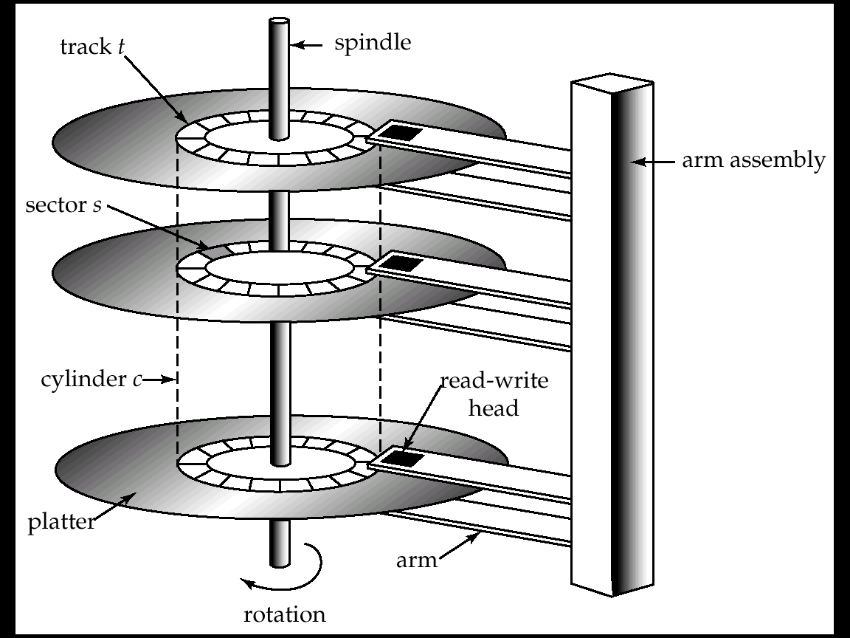
Hard Disk Mechanism

Slide 26
Database Storage
Typically, each table/relation is stored in a separate file on the disk
Each file consists of a collection of records, each corresponding to one row/tuple
Each record consists of a collection of fields, each corresponding to one column/attribute

Slide 27
Indexes
An index is an auxiliary data structure constructed to speed up accesses to a data file
An index is associated with a particular indexing field (which may be an indexing key)
An index is stored in a separate index file
  Each record contains a value of the indexing field, and a block address
  The index file is sorted on the indexing field

Slide 28
A simple index
Index file
Brighton A-217 700
Downtown A-101 500
Downtown A-110 600
Mianus A-215 700
Perry A-102 400
......
A-101
A-102
A-110
A-215
A-217
......
Index of depositors on acct_no
Index records: <search key value, pointer (block, offset or slot#)>
To answer a query for “acct_no=A-110” we:
1. Do a binary search on index file, searching for A-110
2. Follow pointer of index record

Slide 29
Benefits of Indexes
Indexes can speed up various file operations:
  Accessing records according to the indexing field
  Computation of queries ordered/grouped by the indexing field
  Computation of queries conditioned on a range of values of the indexing field
  Computation of joins where tables have a common indexing field

Slide 30
Drawbacks of Indexes
Space to store the index file
  Not a major concern for most indexes
Time to maintain the index file
  A greater concern – index file may have to be modified every time a record is inserted, deleted, or updated

Slide 31
Multilevel Indexes
We can search index files more quickly by creating indexes on them!
  Index file is first-level index
  Create second-level primary index treating first-level index as an ordered data file with key K(i)
Accesses are even faster (than log₂), but maintenance is even more costly
Leads to more complicated B-trees

Slide 32
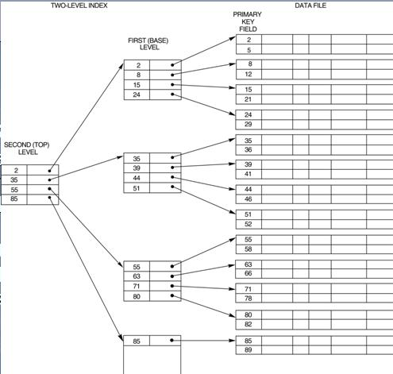

Slide 33
B-tree
Frequently used as a multilevel index
  Leaves contain values of indexing key, in ascending order; all leaves are at the same level
  Each leaf stores one value and a pointer to a block in the data file
  An internal node with q pointers stores q-1 values representing largest values in its first q-1 subtrees
Dynamically reorganizes
  Typically 3-4 levels deep
Demo:
Notes:
http://slady.net/java/bt/view.php?w=1000&h=750

Slide 34
Files and Indexes in Oracle SQL
Tables are by default unordered files
Can create secondary indexes (B-trees) with
CREATE INDEX INDEXNAME
ON TABLENAME(Attribute);

Slide 35
Files and Indexes in Oracle SQL
Can create index-organized tables, with a primary index (B-tree) on the primary key
CREATE TABLE TABLENAME
(
…define table, with primary key…
)
ORGANIZATION INDEX;

Slide 36
Order/Indexing in practice
SELECT *
FROM lineorder
WHERE lo_orderkey=545987;
SELECT *
FROM lineorder
WHERE
lo_ordertotalprice = 21861736;
623K entries in database
orderkey is indexed, ordertotalprice is not
queries refer to the same two rows

Slide 37
Creating an Index
CREATE INDEX OrderTotalPriceIndex
ON lineorder(lo_ordertotalprice);
SELECT *
FROM lineorder
WHERE
lo_ordertotalprice = 21861736;
DROP INDEX OrderTotalPriceIndex;

Slide 38
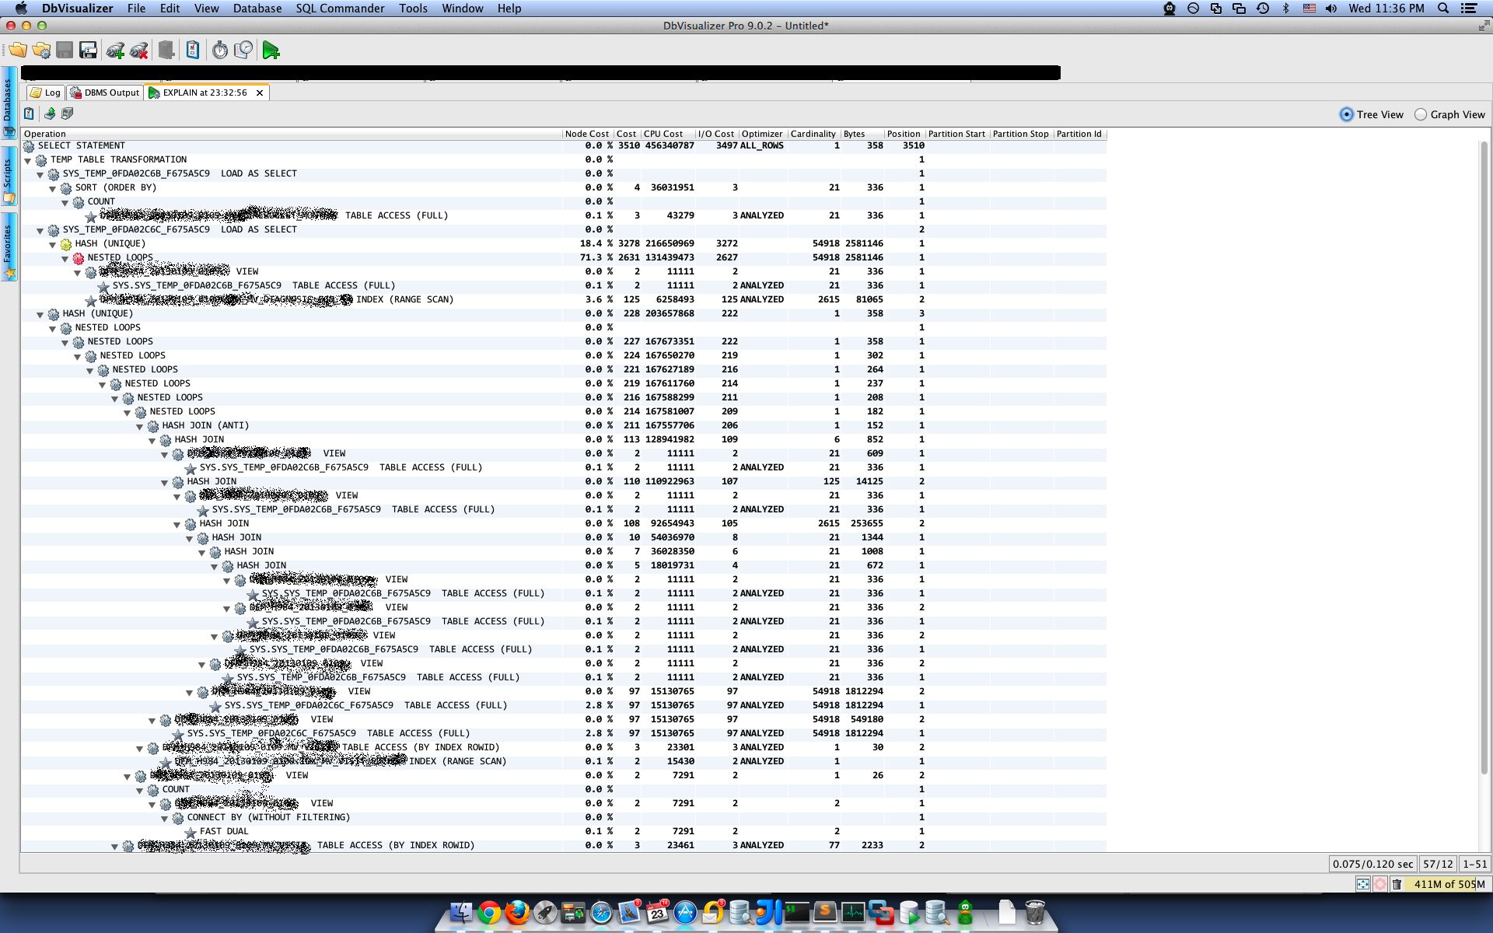


Slide 39
Files and Indexes in other DBs
MySQL: Choice of various storage engines
  MyISAM: Unordered file with B-tree index
  InnoDB: Ordered file with B-tree index
SQL Server
  Allows re-clustering the table on any index at any time (if not unique a uniquefier is introduced)
PostgreSQL:
  Allows index-based re-clustering, but doesn’t maintain the clustered order automatically
DB2
  Similar to PostreSQL (manual REORG)

Slide 40
Views
A view is a “virtual table”
  create view dept_tot_salary(dept_name, tot_salary) as select dept_name, sum(salary)
  from instructor
  group by dept_name
Does not do much to optimize queries
  Security
  Convenience
  (Possibly) query optimization

Slide 41
Materialized Views
Views are nearly cost-free
Automatically updated (with table changes)
… but not very useful
Materialized Views
  Compute and store the query
  Use the view data directly
  Space cost
  Maintenance cost
Dept_Name | SUM(Salary)
Comp. Sci. | 10M
Music | 2M
Economics | 11M
History | 1M
Comics Studies | 500K
Numerology | 750K

Slide 42
Using Materialized Views
Materialized View (MV) is similar to a pre-computed query
  Simpler language semantics
Best case, Q_{i} = MV_{i}
  Maintenance and disk space limitations
Otherwise a lot of work to use
  Pre-join
  Pre-filtered
  Pre-aggregated

Slide 43
Pre-filtered Materialized View
Filter out the relevant rows
  E.g., create view for salary > 75,000
Smaller than the table
Not useful for queries with salary > 74,000

Slide 44
Pre-joined Materialized View
Join tables and store as view
No longer need to perform joins
  Combine with normalization
Potentially much larger than source table
  Redundancy

Slide 45
Pre-aggregated Materialized View
Pre-compute the aggregation
  E.g., average salary by department
Irreversible but smaller
Can be aggregated further

Slide 46
Materialized View Maintenance
The task of keeping a materialized view up-to-date with the underlying data is know as materialized view maintenance
Materialized views using incremental view maintenance
  Changes do database relations are used to compute changes to the materialized view, which is then updated

Slide 47
MV Maintenance
Pre-filtered
  Propagate relevant rows (ignore others)
Pre-joined
  Execute all relevant joins (expensive!)
  Then propagate updates
Pre-aggregated
  For sum/avg can just add new value
  What about delete/min/max?

Slide 48
SQLite
No materialized views
Can use
  CREATE TABLE … AS SELECT
  (no primary keys/constraints)

Slide 49
Next Time:
Python
  Chapter9
Streaming database engines
NoSQL/Hadoop
Read Chapter 7, Chapter 8
(Assignment 6 posted tomorrow)

